Slide 1
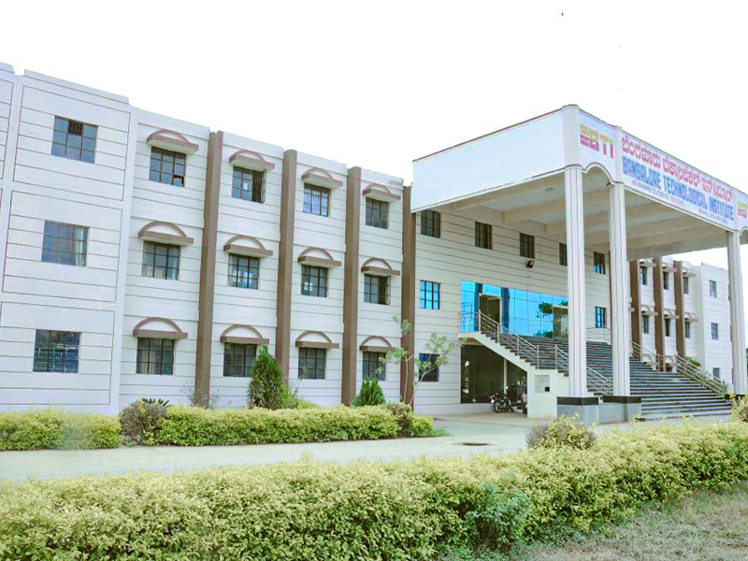

PROJECT PHASE-II
1st – REVIEW
PRESENTATION
ON
IOT BASED
“SMART SHOPPING COMPLEX”
GROUP MEMBERS:
Michael Thapa 1BH18CS055
Prabin Upadhayaya 1BH18CS070
Dan Bahadur Shahi 1BH18CS108
Anish Thapa 1BH18CS112
UNDER THE GUIDANCE OF:
Mrs. Bhavya R
Asst. Professor
DEPARTMENT OF COMPUTER SCIENCE & ENGINEERING
BANGALORE TECHNOLOGICAL INSTITUTE
BANGALORE-560035
Notes:
Links:
https://unsplash.com/photos/Pihl8kTtX-s

Slide 2
CONTENT
Abstract
Introduction
Objective
Literature Survey
Existing System and Proposed System
Circuit Diagram
Software Requirement Specification
Implementation
Conclusion
References
Department of Computer Science and Engineering 2021-22

Slide 3
ABSTRACT
In today's life, going to the supermarkets to shop is growing rapidly. During this pandemic, not everyone knows about and follows safety measures. Therefore, maintaining all of these measures is essential for client safety. Time is taken at the billing desk and must be in the queue until the round arrives. Required to get rid of them, Our project provides the basis of a system proposal based on RFID technology. The system contains the elements attached with an RFID label and an RFID reader that reads the label information when placed on the trolley. Then this information is sent to the central billing server, which calculates the total amount of purchase items and sends the computed bill to the device attached to the trolley for displaying it on the LCD. At the same time, we have introduced a vehicle parking system. Here there is room to park a car or not will be displayed on the LCD screen at the front door of the parking lot. As a result, customers will be able to park easily. And also, looking at the present situation, we have planned a mask detector and an automatic disinfection sensor at the entrance of the complex before entering. And also, once we get into the complex, we can get a map of this particular complex to see things in which stands we can find. It will be easy for people to get to the bottom of things and buy them. In addition, the LCD screen will show the entire complex indoors.
Department of Computer Science and Engineering 2021-22

Slide 4
INTRODUCTION
Internet of Things (IoT) is the network of physical objects embedded with Radio Frequency Identification (RFID), embedded systems, sensors, networks, and software that enable physical objects to collect and exchange data for a common goal.
Everyday objects can now be equipped with computational power and communication features to connect things anywhere.
This has led to a new revolution in industrial, financial, and environmental systems and has created significant challenges in data management, wireless communications, and real-time decision-making.
Additionally, many security, and privacy issues have emerged, and lightweight cryptographic methods are in high demand to integrate with its applications.
Much of the Internet of the Things research has focused on various applications, such as smart homes, online health systems, and portable devices.
Department of Computer Science and Engineering 2021-22

Slide 5
This paper focuses entirely on the shopping complex for safety and saving people's time.
Here mask detecting sensors, temperature measuring, and automatic sanitizing will be provided at the mall entrance.
After that, when we enter the mall, each person can get the map of the mall where locations of different kinds of stuff will be provided as well as anyone can see maps of the mall in LCDhe LCD will be displayed in the center of the mall.
An innovative shopping system based on Radio Frequency Identification (RFID) technology has not been well-studied.
In such a system, all items for sale are attached with an RFID tag to be tracked by any device equipped with an RFID reader in the store –for example, a smart shelf.
It becomes easy for the store to do inventory management as all items can be automatically read and easily logged.
Department of Computer Science and Engineering 2021-22

Slide 6
OBJECTIVES
Assure the health of the customers with proper protocols during pandemics like COVID-19,
Minimize time complexity for billing with a smart trolly,
Guiding customers to their particular area of interest (i.e. stalls) through map/display,
QR code for secure transactions,
QR pass to exit door for security purposes,
Minimum human manpower.
Department of Computer Science and Engineering 2021-22

Slide 7
LITERATURE SURVEY
S . No | Paper Title & Year | Name of the Author’s | Discussed | Remarks
1 | Smart Cart Shopping System with an RFID Interface for Human Assistance, 2020 | S. Lakshmanachari, G. Avanthi, Vallabhuni Vijay | The main idea is to save customers time by providing digital billing system. A compartment of all the products will be attached with RFID tags/cards, and the purchasing product information will get stored in the database. The billing will then get generated in the LCD as well as the Server. This research work utilizes RFID reader, LCD and Wi-Fi transmitter in the advanced mobile trolley | To decrease the time at billing, RFID arrangement has been proposed. Each advanced mobile truck will be provided with an RFID reader, Raspberry pi 3, Arduino, and LCD. The framework holds the things joined for RFID tag. RFID reader proceeds with the tag data when it is required to add or remove items from the trolley.
Department of Computer Science and Engineering 2021-22

Slide 8
S .No | Paper Title & Year | Name of the Author’s | Discussed | Remarks
2 | Self-Activating Sanitizer with battery imposed system for Cleansing Hands, 2020 | Mr. M. M. Srihari | It has three modes of Control LED’s in the system, White LED is used for the user to understand that the setup is in working mode and battery is in use. Red LED is used for the user to understand that Battery is in charging mode. Green LED is used for the user to understand that battery is in full charged mode. | Provide continuous power supply instead of using battery minimizing the cost as LEDs are not needed for displaying the battery status.
3 | Smart Door / COVID-19 Face Mask Detection , 9 July 2021 | Pavan Narayana A, Janardhan Guptha S, Deepak S, Pujith Sai P | To prevent the spread of the covid-19 by monitoring in real time if person is wearing face masks in public places. | We can get the details of the people who are not wearing masks and when it comes to school or working office premises, we this will be very useful
Department of Computer Science and Engineering 2021-22

Slide 9
EXISTING SYSTEM
An intelligent trolley for human assistance was proposed; a customer had to press add/subtract button for the addition/subtraction of the items.
The item's information had to be sent to the central billing server. Calculate the total amount of purchase items. It would be displayed on the web page, then pay, but it didn't mention how the information would be sent, and no receipt was provided.
A hand sanitizer was proposed in which batteries were used as the source of power, which would not last for long and had to charge time and again.
A face mask detection and temperature measurement were proposed but had not mentioned the gate pass to the mall, During such a pandemic of COVID, volunteers were needed to maintain a queue and other Crowdy activities, Customers used to get dull as they were new to the mall and didn’t know where to find their respective choices like the clothing section, the sports section and so on, Didn’t know about the parking status.
Department of Computer Science and Engineering 2021-22

Slide 10
PROPOSED SYSTEM
At the entry gate, customers will be guided to parking zones, Customers will be provided some protocols for their safety,
Hand sanitizer with continued power supply through the battery, Allow the pass if and only if the customer is wearing a mask and has a cover, Customers are guided through indoor maps/displays to their respective stores like sports, restaurants, etc.
QR code for easy and reliable payment to overcome the payment process, Barcode generation for the exit for security purposes, i.e., QR Customers who don't get a secondary QR code for the exit pass.
Department of Computer Science and Engineering 2021-22

Slide 11
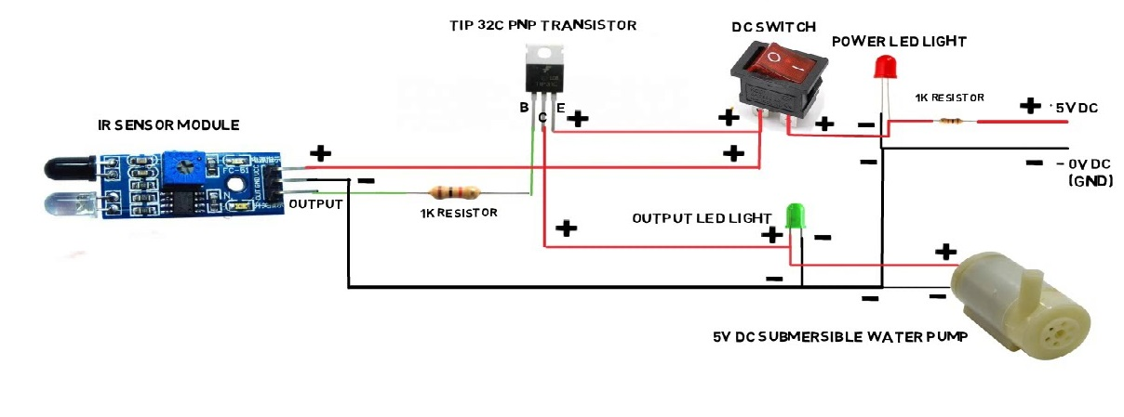
CIRCUIT DIAGRAMS
Figure 1: Auto Hand Sanitizer
Department of Computer Science and Engineering 2021-22

Slide 12
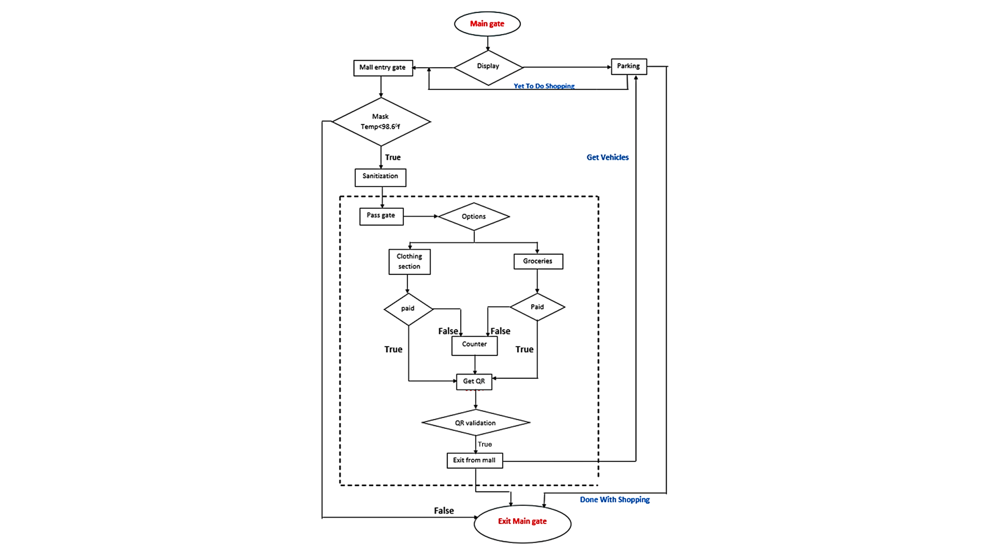
ARCHITECTURAL FLOW DIAGRAM
Figure 2: Flow Diagram
Department of Computer Science and Engineering 2021-22

Slide 13
SOFTWARE AND HARWARE REQUIREMENT
SOFTWARE
HARDWARE
Python
Arduino Sketch_dec
IDE- VS code/PyCharm/Collab
IR Sensor Module
Resistor 1k
Transistor TIP32C
Mini Water Pump 5v
Wires
Transparent Flexible pipe
16:2 LCD Display
Arduino Nano
TMP36(temperature sensor)
RFID reader, RFID tag
Buzzer
Department of Computer Science and Engineering 2021-22

Slide 14
IMPLEMENTATION
The main objective of the our project, Assure the health of the customers with proper protocols during pandemics like COVID-19 using the automatic hand sanitizer and face mask detection while entering to the mall. Minimize the customer time complexity for billing with smart trolley.
Till now we have completed face mask detection, auto hand sanitizer and car parking display implementation.
In face mask detection, it will check whether the person is wearing mask or not , if wearing access will be granted otherwise access denied.
In automatic hand sanitizer project if we keep any object in front of the IR sensor, it will detect that and then through the pump sanitizer will come out.
We can implement this model in such a way that If we add face recognition along with mask detection. This would be very useful and we can store this data and understand metrics like how well the people are following COVID-19 guidelines.
Department of Computer Science and Engineering 2021-22

Slide 15
AUTO HANDSANITIZATION
This project gives a brief idea about the automatic hand wash sanitizer. The motor pumps the sanitizer liquid or solution to the human while detecting the IR Sensor.
The IR Sensor is the photodiode used for sensing the human hand detection and it is used to control the motor pump from the liquid.
The motor is connected to an RC timer delay setup and the pipe connected to a reducer are used to control the flowing liquid of the sanitizer.
It has an On/ Off switch to control the whole setup from the battery supply. The consumer is convenient to use the setup and the user also saves costs and power.
The human hand detector for the touchless sensor. It senses through the infrared radiation.
If we keep our hand in front of the IR sensor then it detected object and sanitizer come out .
Department of Computer Science and Engineering 2021-22

Slide 16
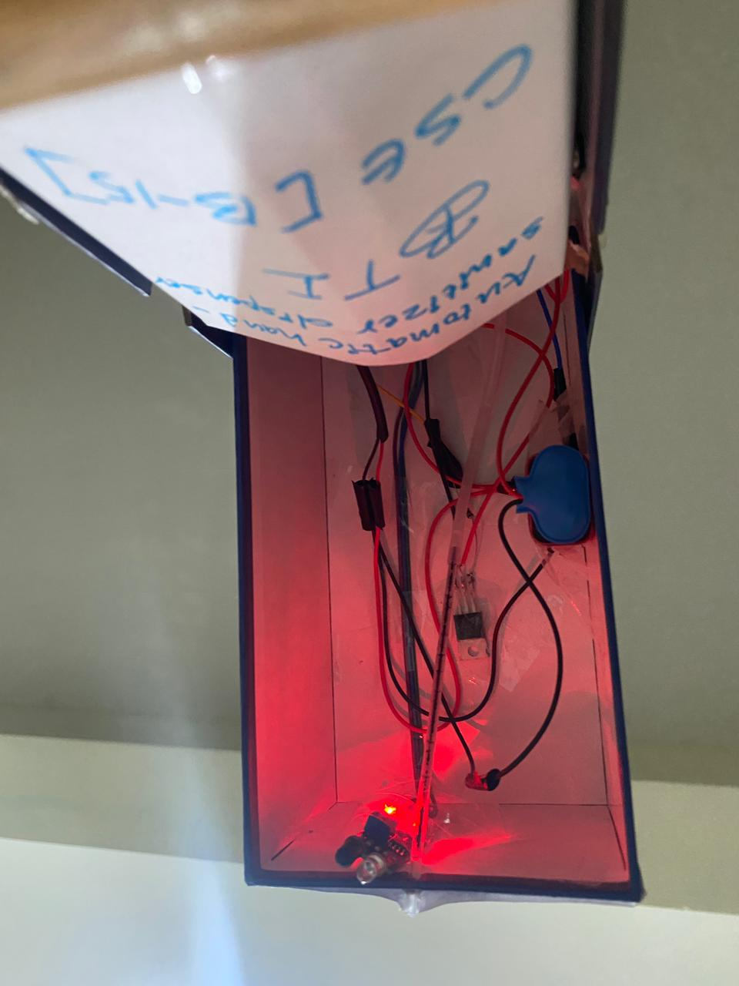
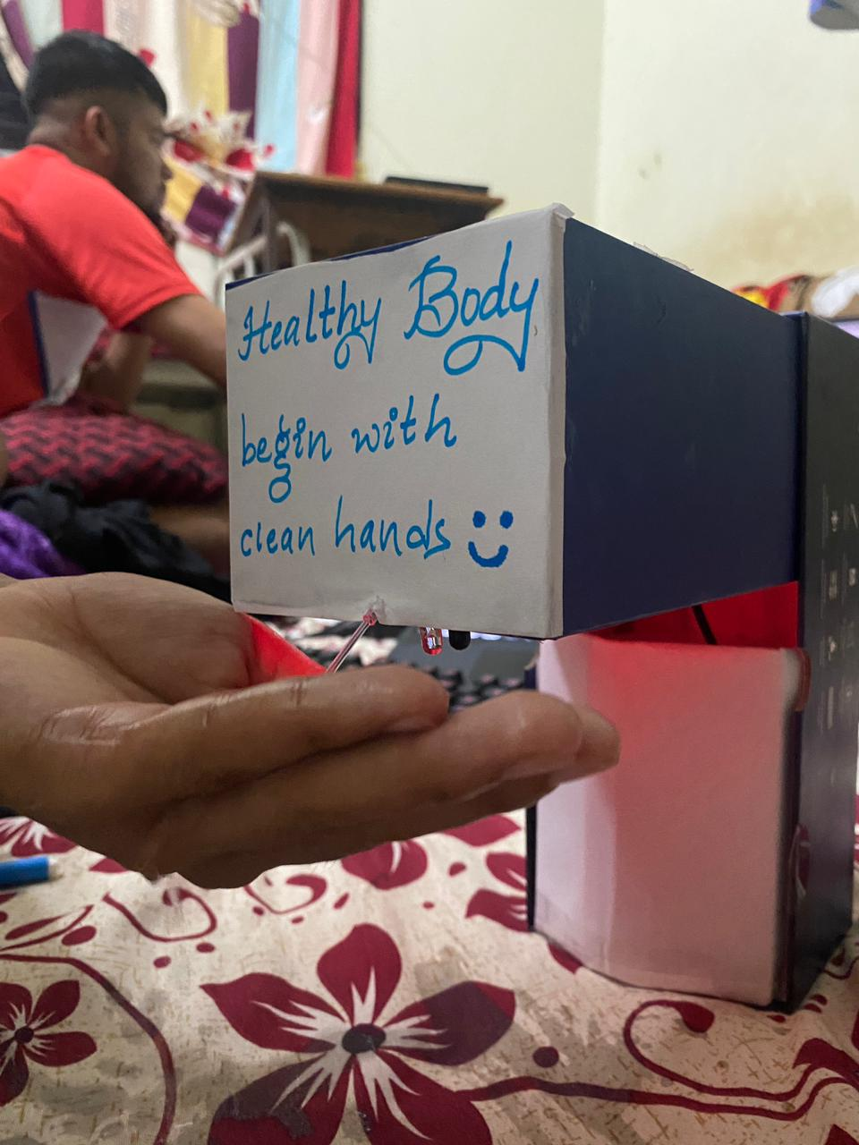
Figure 3: Automatic Hand Sanitizer with Microcontroller

Slide 17
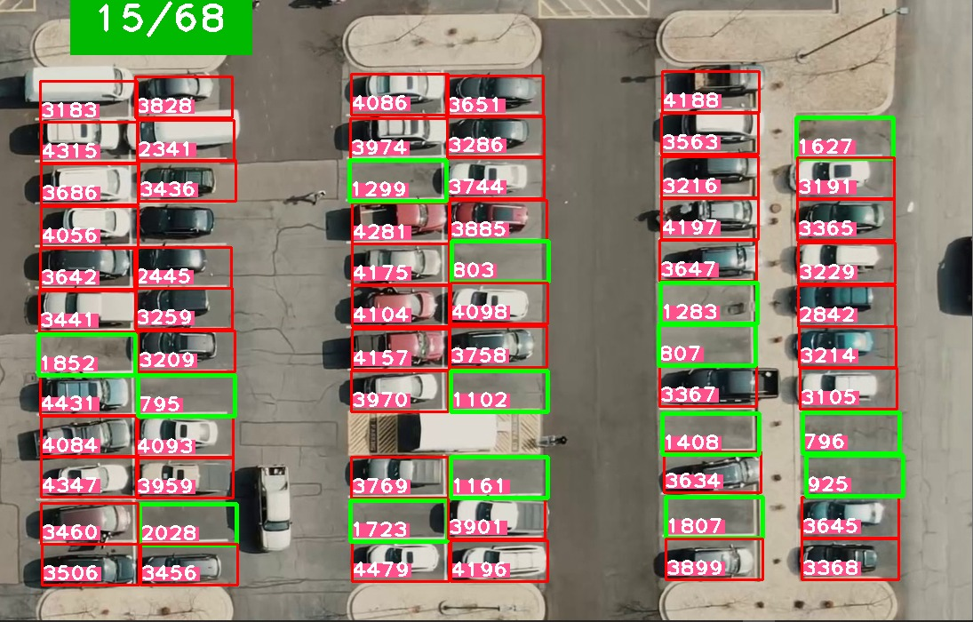
SMART PARKING
An intelligent parking system is designed to avoid traffic jams and save time.
Here, the system is trained to detect and predict if the parking space is empty.
Figure 4: Car Parking system
Department of Computer Science and Engineering 2021-22

Slide 18
FACE MASK DETECTION
A Few nations around the globe have utilized face masks obligatory out in the open to help control the spread of COVID-19.
There is a danger of boundless network transmission, and Physical separation is troublesome, for example, on an open vehicle, in shops, or other shut settings. So we thought bringing an intelligent door into the market, which detects if the person is wearing a mask or not, is crucial to society.
Now we should come back to our everyday lives. To do that, we need to stop the spread of the virus; everyone should wear a mask to make that possible. So we are implementing this face mask detection using OpenCV.
OpenCV is a library of programming functions mainly aimed at real-time computer vision, used to acquire images from webcam or other camera modules.

Slide 19
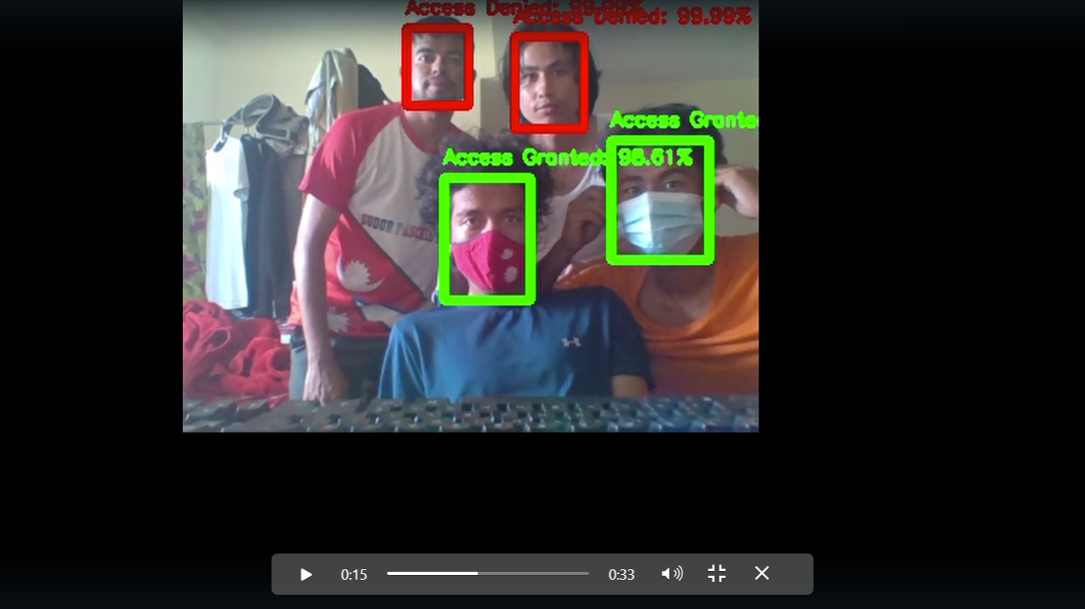
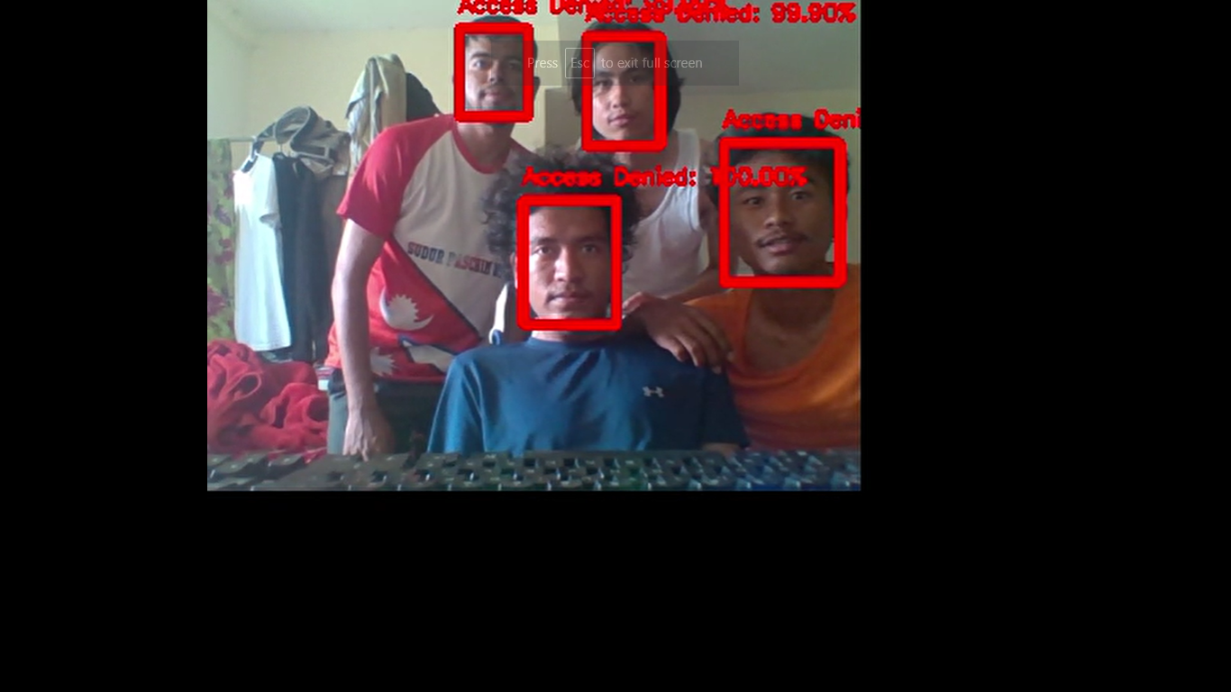
Result : I
Result : II
Figure 5: Mask detection system

Slide 20

Figure 6: Simulation of the mask detection system

Slide 21
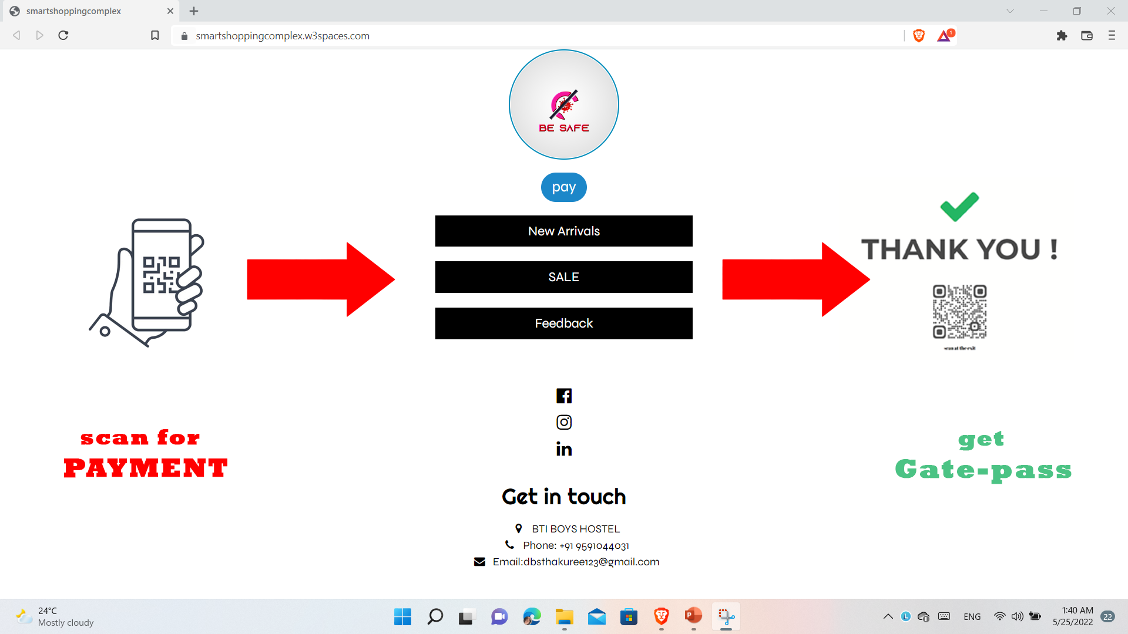
SMART TROLLEY [PAYMENT]
Innovative payment should be made through the web, which is easy and saves time instead of the billing queue.
Once payment has been completed, a pass is provided.
Figure 7: payment through web

Slide 22
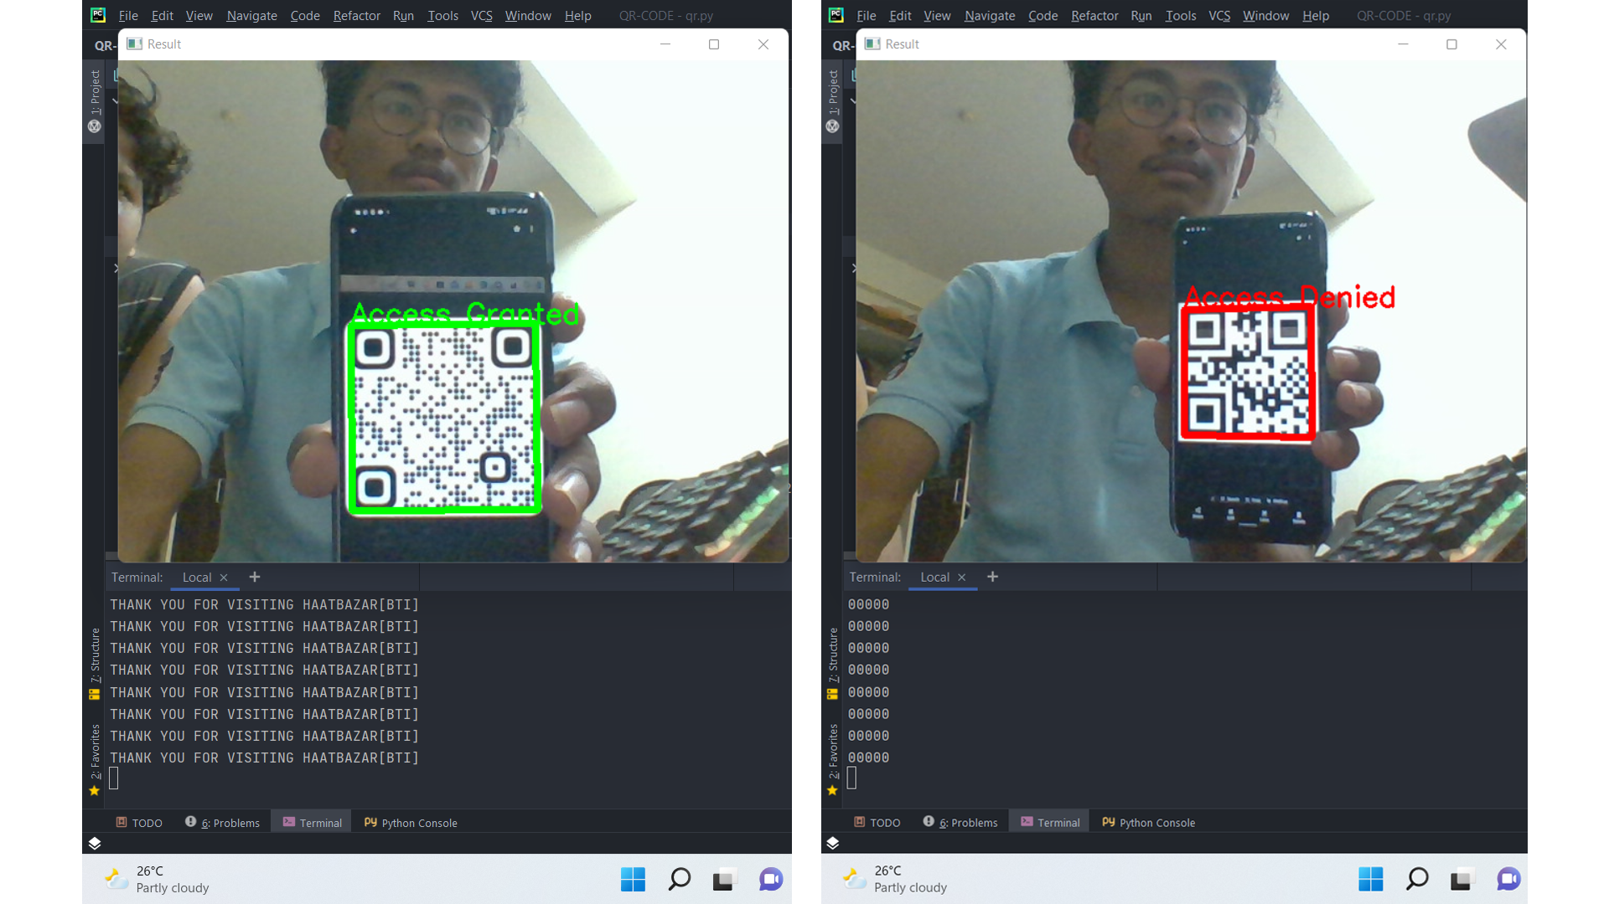
SMART GATE PASS
An intelligent gate-pass system is designed for the intelligent and secured gate to the exit.
The system is trained to detect the QR code and then grant or reject it.
Figure 8: Gate Pass

Slide 23
CONCLUSION
Our project demonstrates the use of AI integrated with the Internet of Things in the management of the smart shopping complex with important precautions in situations like the COVID-19 pandemic. This project featured an intelligent commercial complex with an advanced vehicle parking system, mask detection, temperature measurement, and automatic disinfection at the complex entrance. Clients have a smart trolley for quick billing. The Arduino and Ultrasonic sensors are used in this design
Department of Computer Science and Engineering 2021-22

Slide 24
REFERENCES
[1] Suraj. S, Vishal Guruprasad, Udayagiri R.P., Preetham S Nag, “RFID Based Wireless Intelligent Cart Using ARM7,” International Journal of Innovative Research in Science, Engineering and Technology, vol. 5, iss. 8, 2016
[2] Smart Trolley in Shopping Mall Rahul Chaudhari1 , Sunil Bhagat2 , Shubham Kanfade3 , Mayuri Taklikar4 , Snehal Bhajikhaye5 , Prof. S. P. Chaware6 1-5 Students,6Assistant Professor Information Technology, Priyadarshini College of Engineering, Nagpur, Maharashtra, India(440019)
[3] Proceedings of the Second International Conference on Inventive Research in Computing Applications (ICIRCA-2020) IEEE Xplore Part Number: CFP20N67-ART; ISBN: 978-1-7281-5374-2 Self-Activating Sanitizer With Battery Imposed System For Cleansing Hands Mr. M. M. Srihari * Coimbatore, Tamil Nadu, India
[4] Kavitha, S. M. M. Roomi, K. Priya, K. B. Devi, “State model based face mask detection”, International Journal of Engineering & Technology, 7 (2.22), pp. 35-38, 2018
[5] YouTube, Google, Sci-Hub
Department of Computer Science and Engineering 2021-22

Slide 25
THANK YOU

